Slide 1
Unlocking
Toastmasters Club Success
How Pathways & the DCP
Fuel Member Growth and Club Excellence

Slide 2
"When leadership keeps the plan to themselves, they build disconnection, not success.
Great leaders invite others into the vision,
so everyone can rise together."
- Amanda Cuda -

Slide 3

What we’ll cover
The Toastmasters Club Officers’ greatest tool and secret weapon for club success!

Slide 4
What we’ll cover.. Cont.
Toastmasters Education Program (Pathways)
Distinguished Club Program (DCP)
How Officers Can Use the DCP to Drive Member Engagement
Creating Buy-In: Bringing the DCP Back to Your Club Members
Officer Takeaway: Lead with Purpose, Not Pressure

Slide 5
Toastmasters Education Program 101
Welcome to Pathways
The opportunity to build more than 300 unique skillset competencies
6 specialized learning paths
Online content, affording you to learn anytime, anywhere
Real-world, transferable skills
Content is available in Arabic, English, French, German, Simplified Chinese, and Spanish.

Slide 6
Toastmasters Education Program 101
Pathways learning experience
Offering members 6 specialized learning paths
  Presentation Mastery
  Dynamic Leadership
  Engaging Humor
  Motivational Strategies
  Persuasive Influence
  Visionary Communication
Discontinued paths
  Effective Coaching
  Innovative Planning
  Leadership Development
  Team Collaboration
  Strategic Relationships
  No new enrollments will be allowed in these paths.

Slide 7
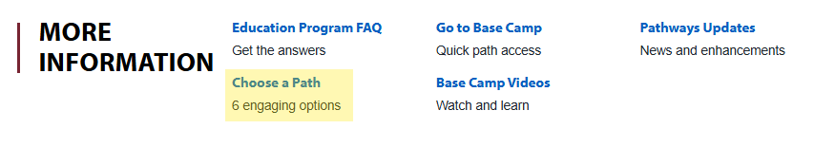
Pathways – Steps to selecting a Path
Login to https://www.toastmasters.org/
Select Education Programs – from the top menu bar
Choose a Path

Slide 8
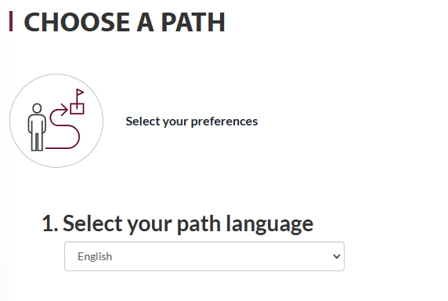
Pathways
Select your path language

Slide 9
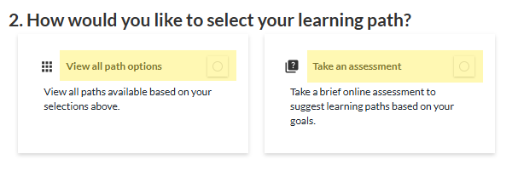
Pathways
How would you like to select your learning path?

Slide 10
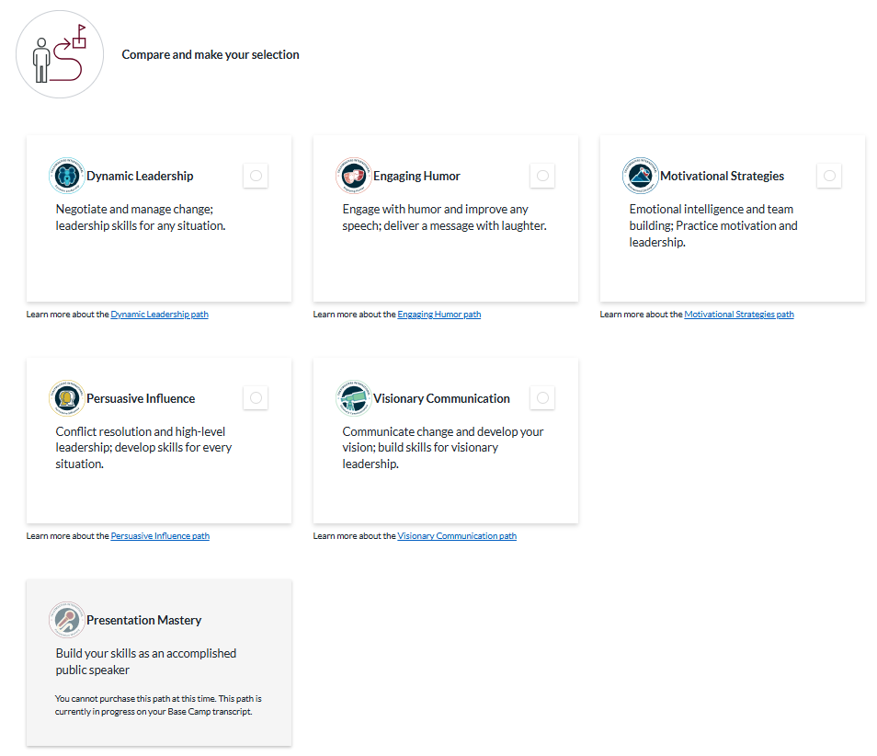
Pathways

Slide 11
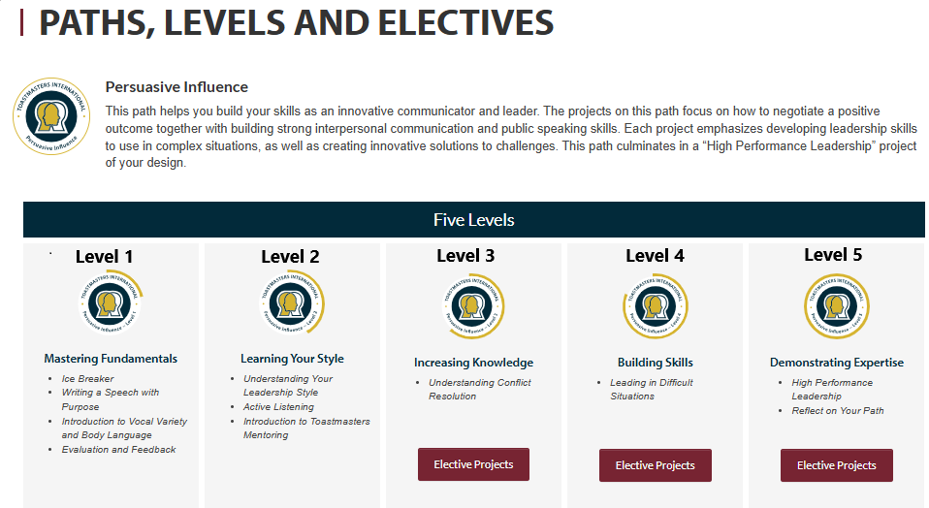

Slide 12
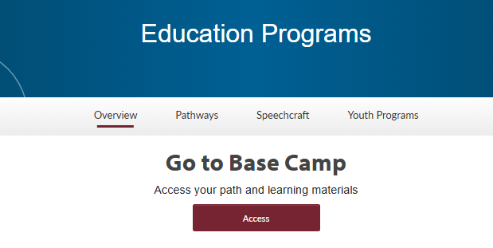
Pathways - Step 2 – Work your path!
Log in to https://www.toastmasters.org/
Select Education Programs
Go to BASE CAMP

Slide 13
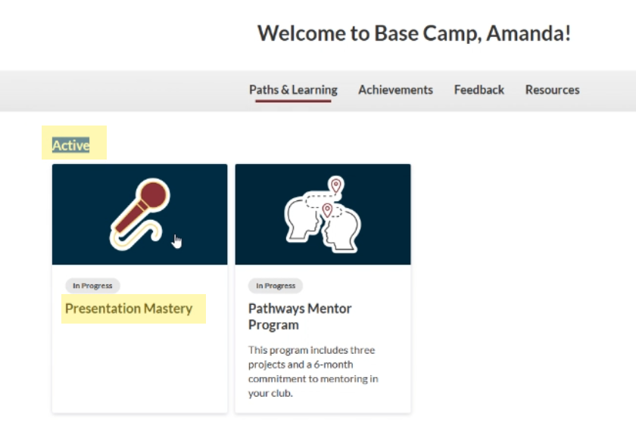

Slide 14
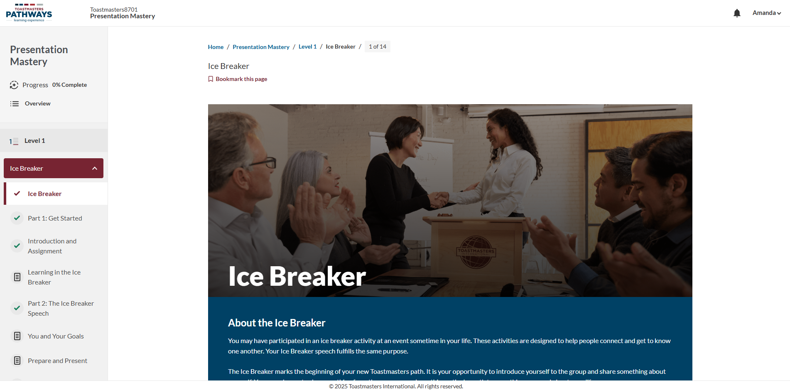

Slide 15
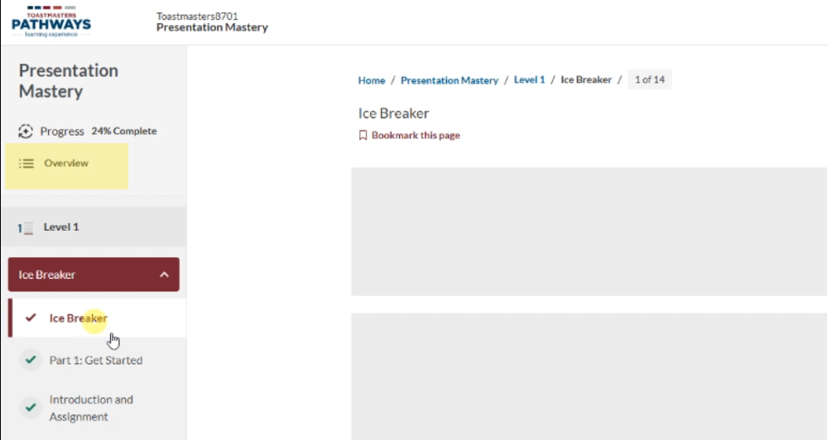

Slide 16
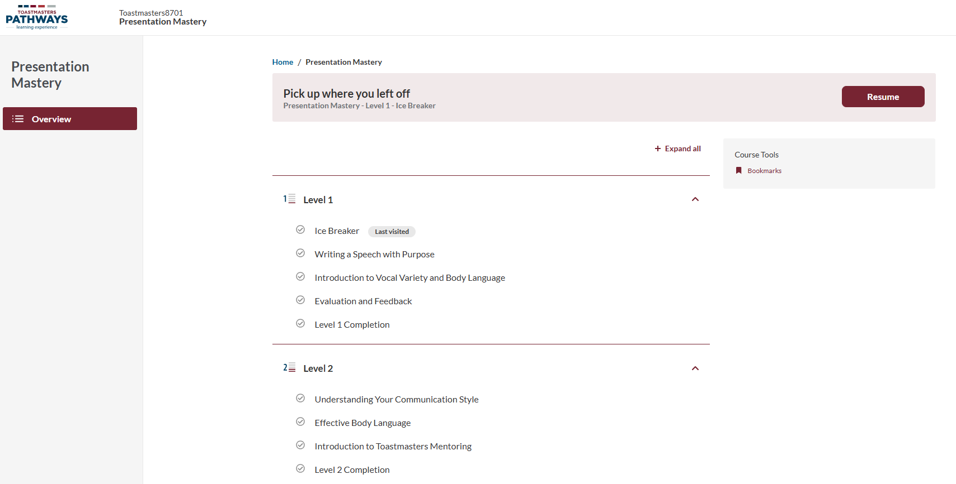

Slide 17
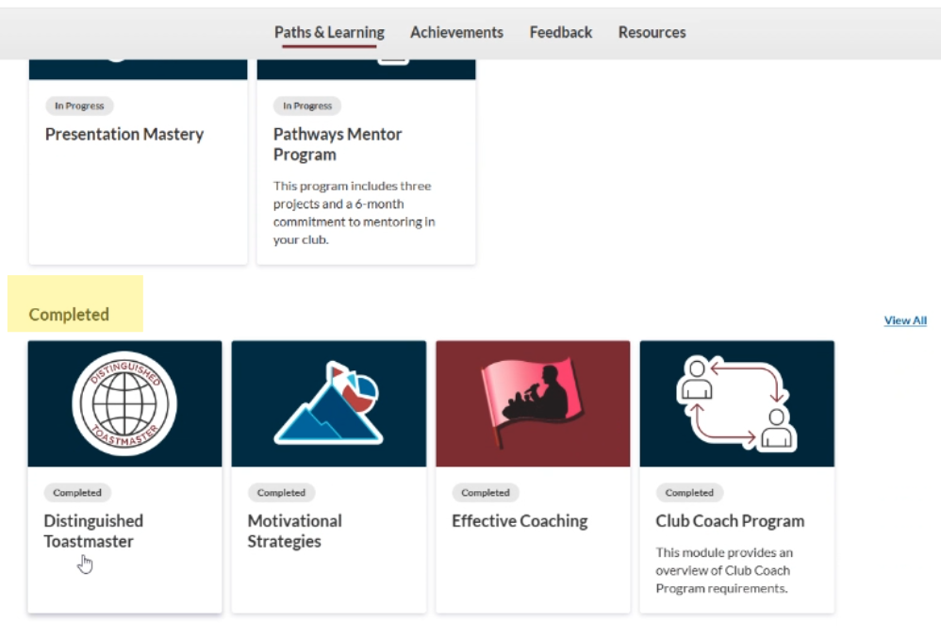

Slide 18
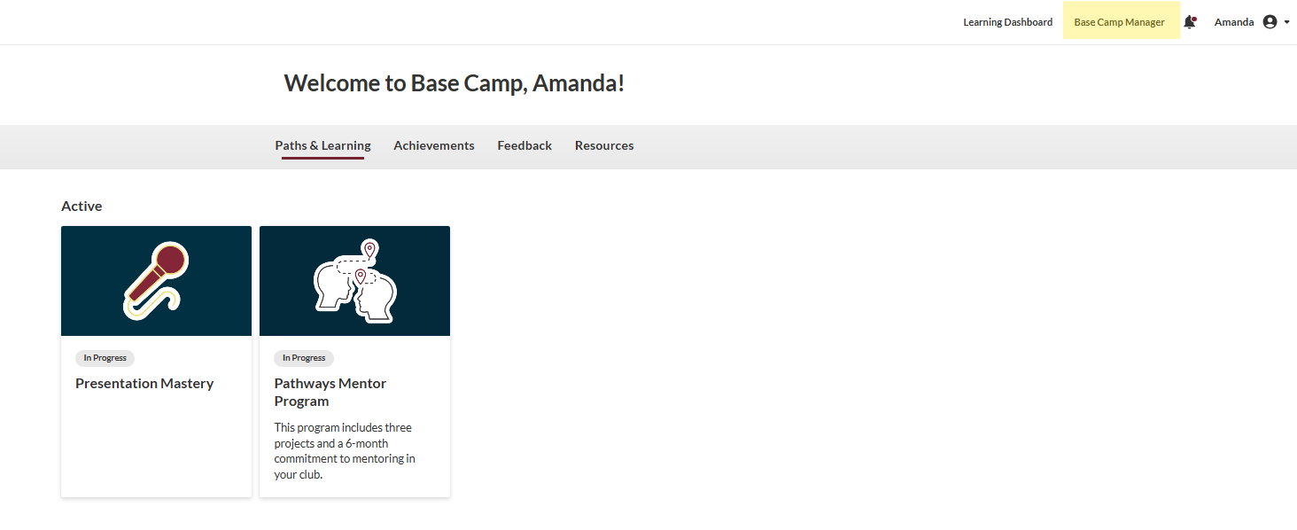
Pathways – Base Camp Manager
How to approve member projects

Slide 19
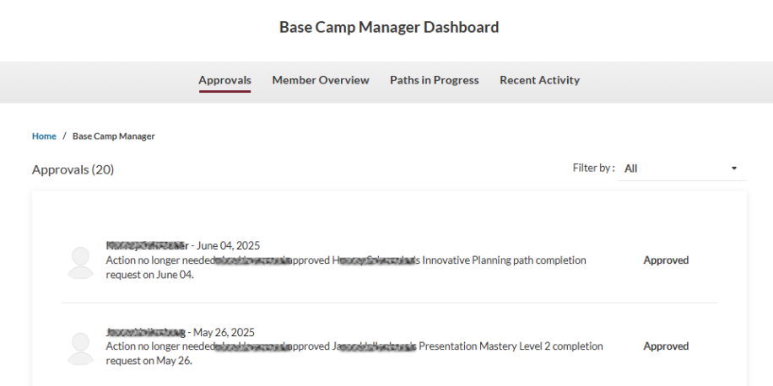
Pathways – Base Camp Manager

Slide 20
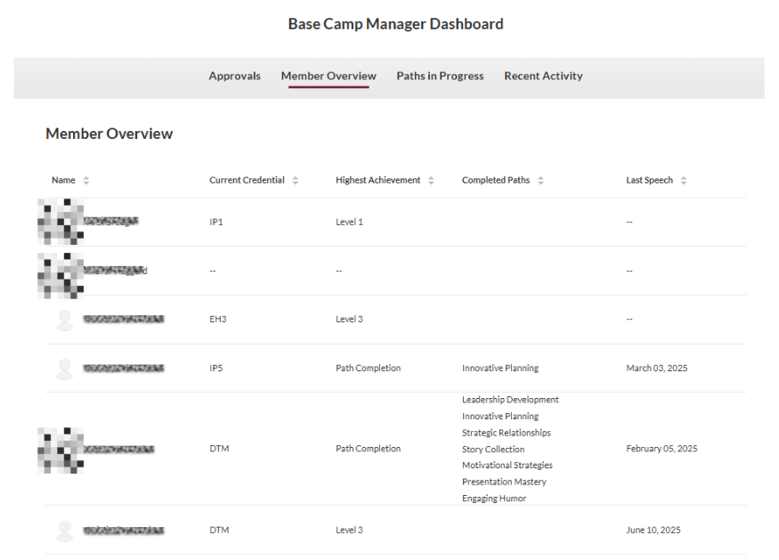
Pathways – Base Camp Manager

Slide 21
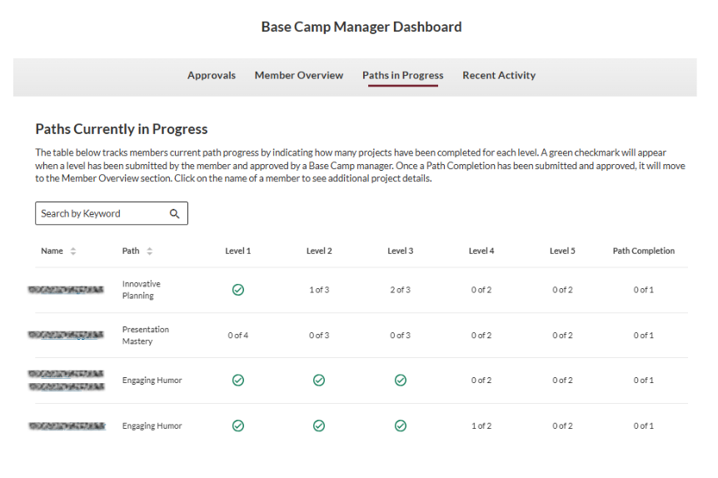
Pathways – Base Camp Manager

Slide 22
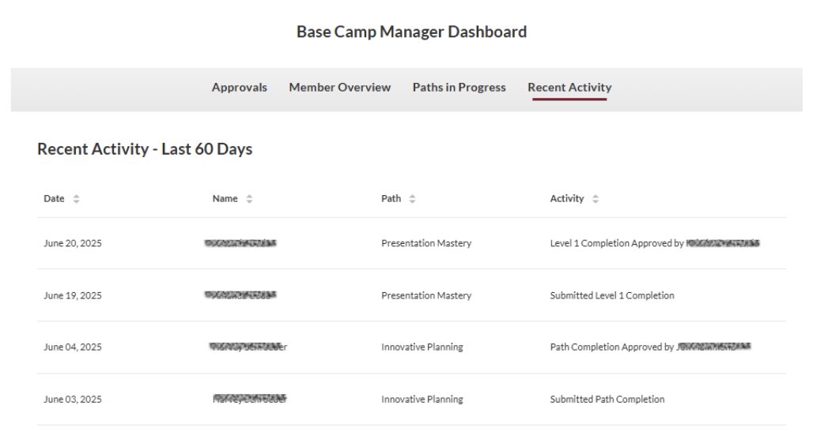
Pathways – Base Camp Manager

Slide 23
What is DCP?
Distinguished Club Program
Performance-based recognition program
Quality member experience.
Consists of 4 Categories
  Member Education
  New Club Membership
  Club Officer Training
  Club Officer Administration

Slide 24
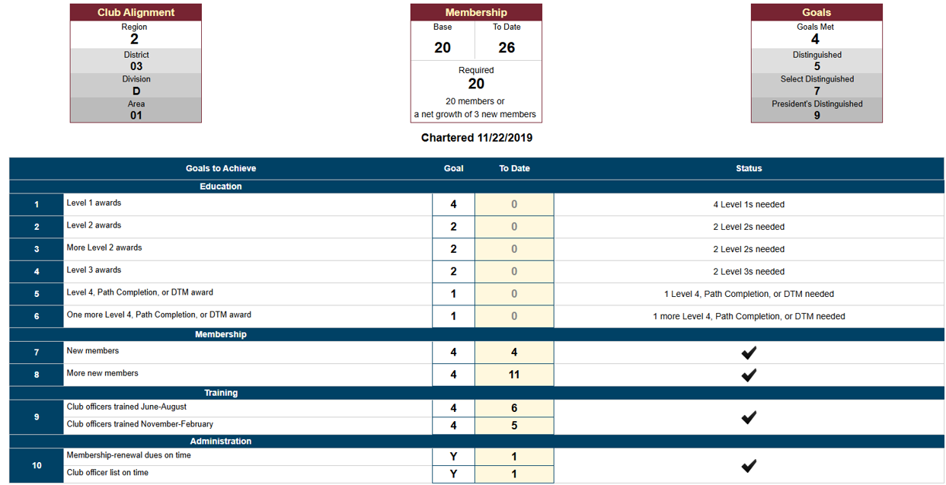

Slide 25
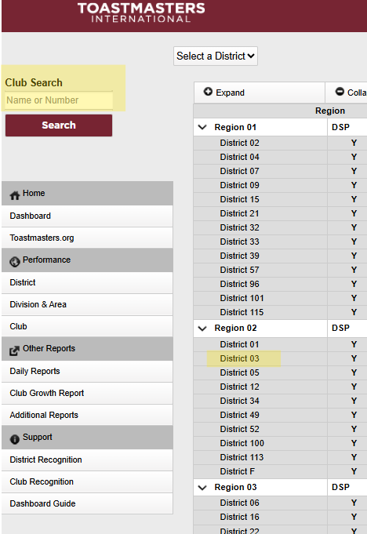
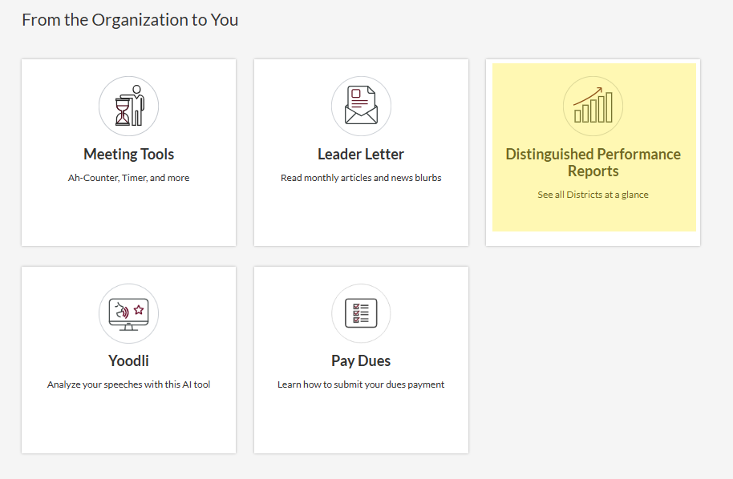
How to find your Club’s DCP Dashboard
Go to: https://dashboards.toastmasters.org/
  Search for your club's name
  Go to Region 2 -> District 3
Log in to TI
  Home
  From the Organization to You

Slide 27
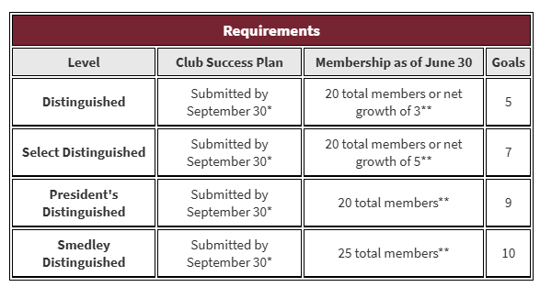
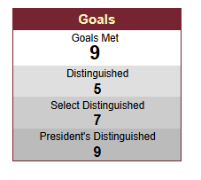
DCP – New Changes coming in 2025-2026
A new qualifying requirement:
Complete and submit your Club Success Plan by September 30
Introduction of the prestigious Smedley level achievement for clubs that:
  Maintain at least 25 members, and
  Accomplish all 10 Distinguished Club Program goals

Slide 28
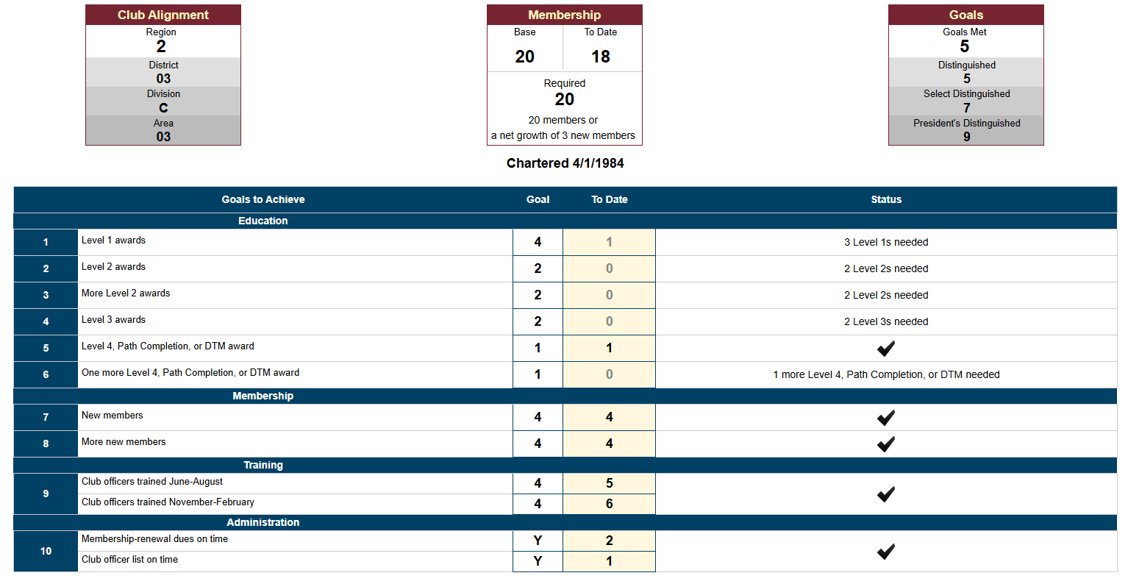

Slide 30
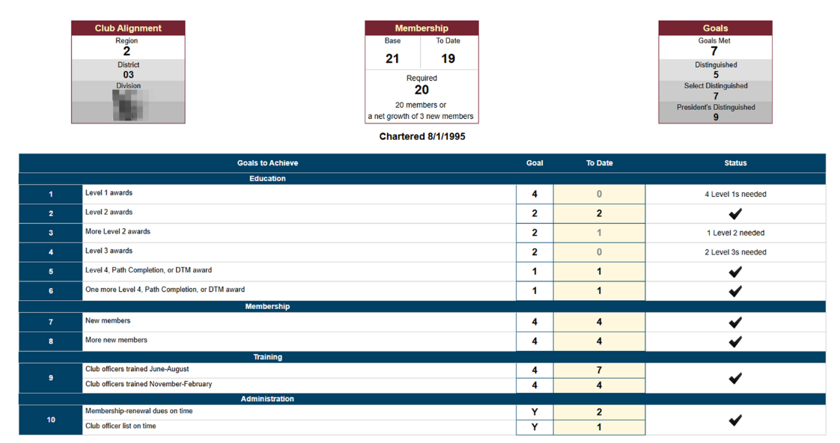
Notes:
Needs 1 member

Slide 31
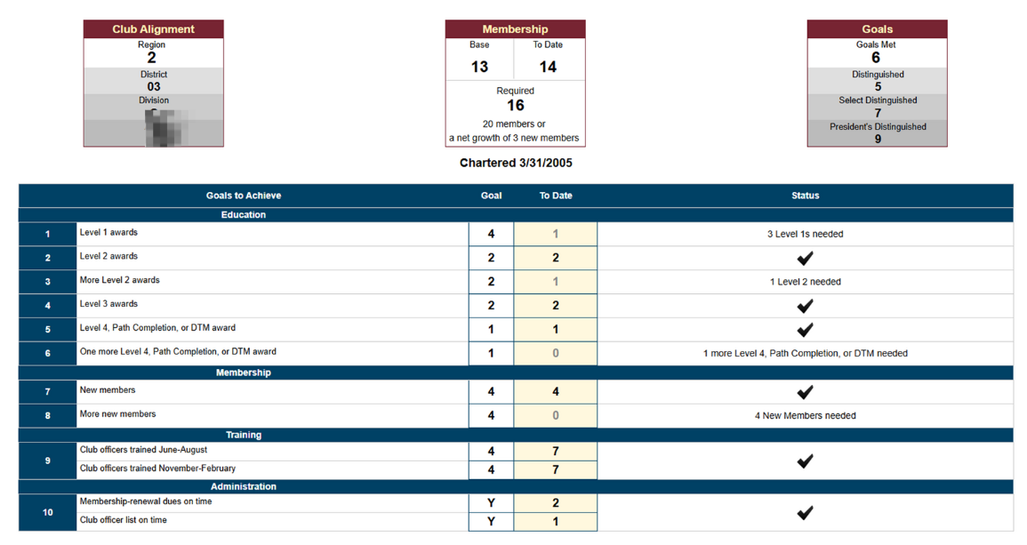
Notes:
Needs 2 members

Slide 32
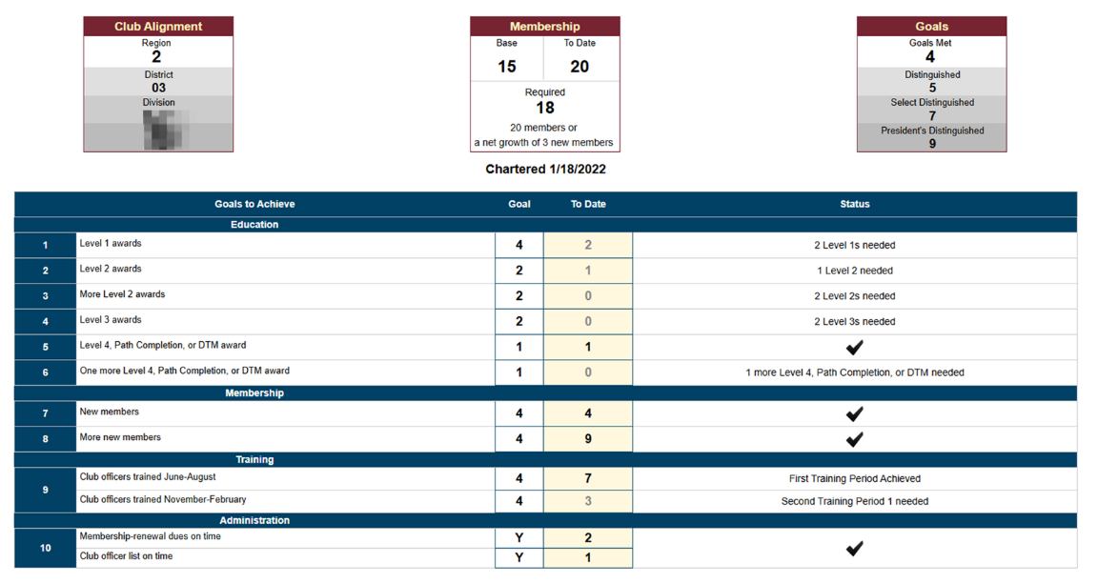
Notes:
Met Membership – needed one more goal in either education or training

Slide 33
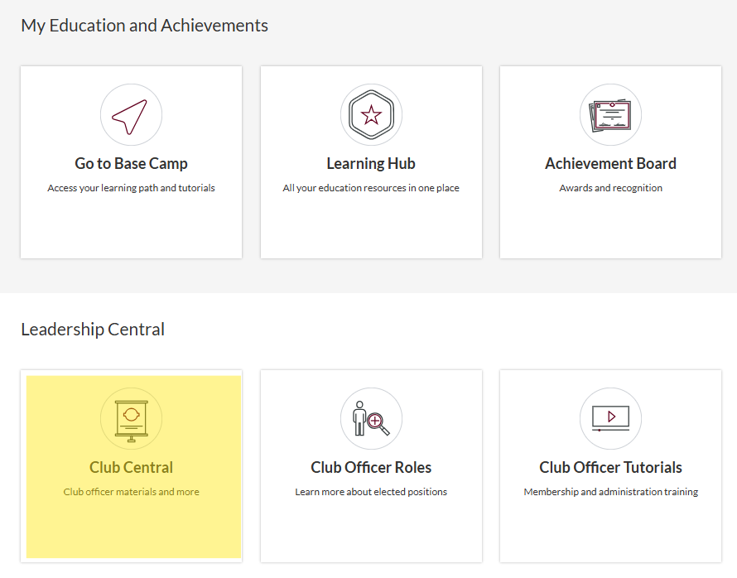
Where to find the Club Success Plan
Go to: https://www.toastmasters.org/myhome
Leadership Central

Slide 34
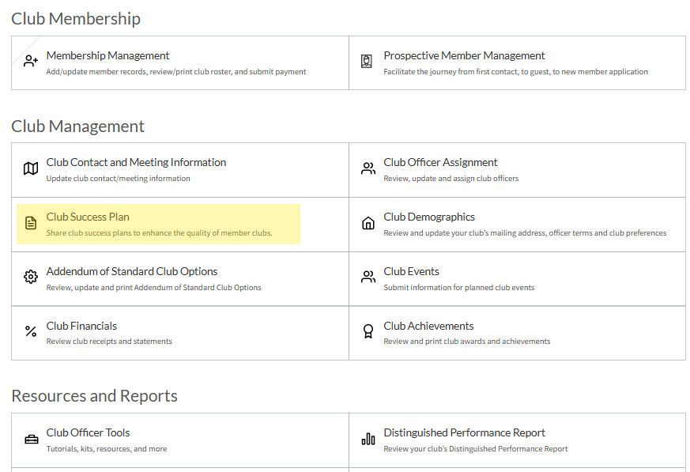
Where to find the Club Success Plan.. Cont.

Slide 35
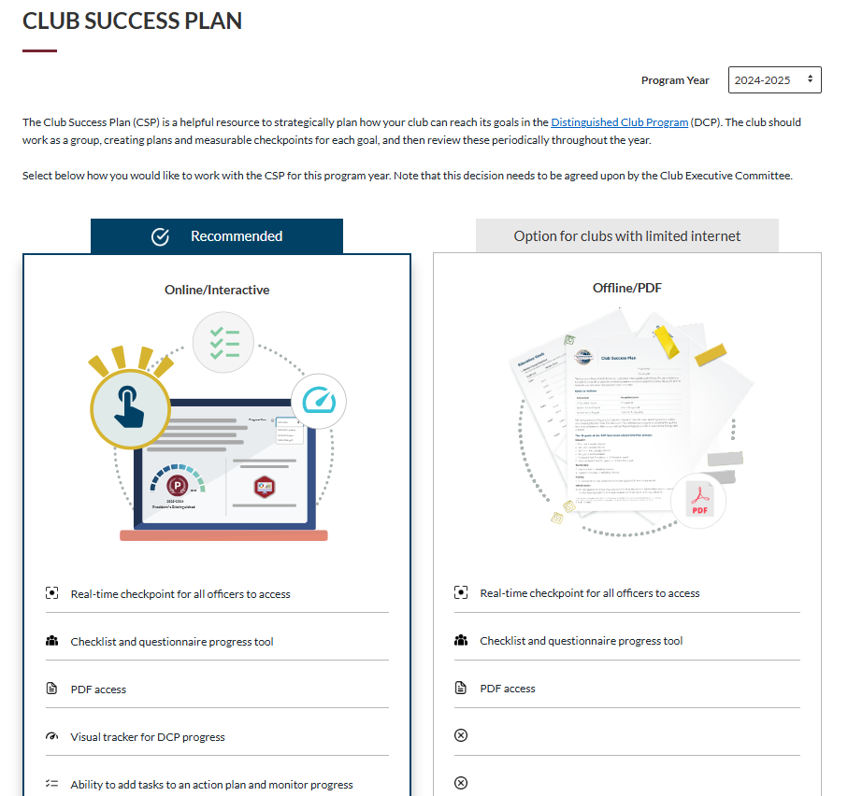
Where to find the Club Success Plan.. Cont.

Slide 36
What is the Club Success Plan?
The Club Success Plan is a helpful resource for the Club Executive Committee and club members to strategically plan and map out how the club will achieve its desired goals within the Distinguished Club Program.
The club should work together as a group, creating action plans and measurable checkpoints for each goal. The club should review these things periodically throughout the year.
Notes:
A 10 page document

Slide 38
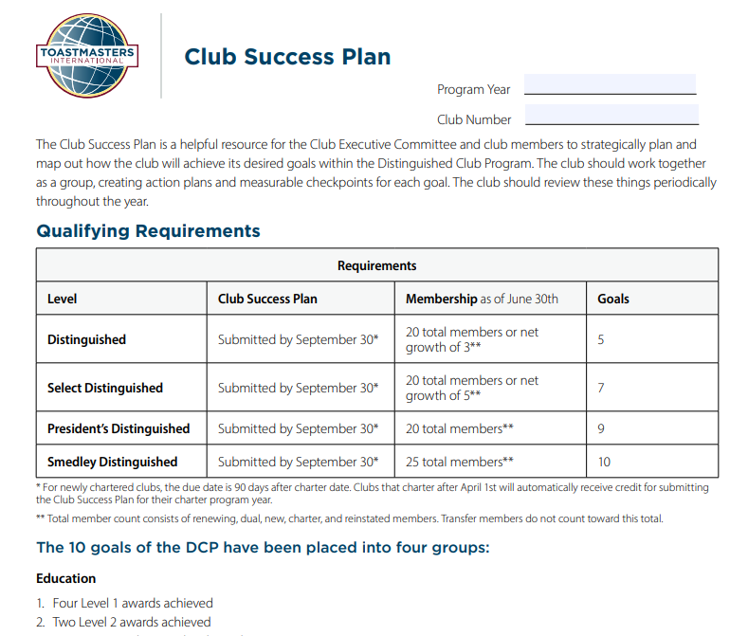

Slide 39
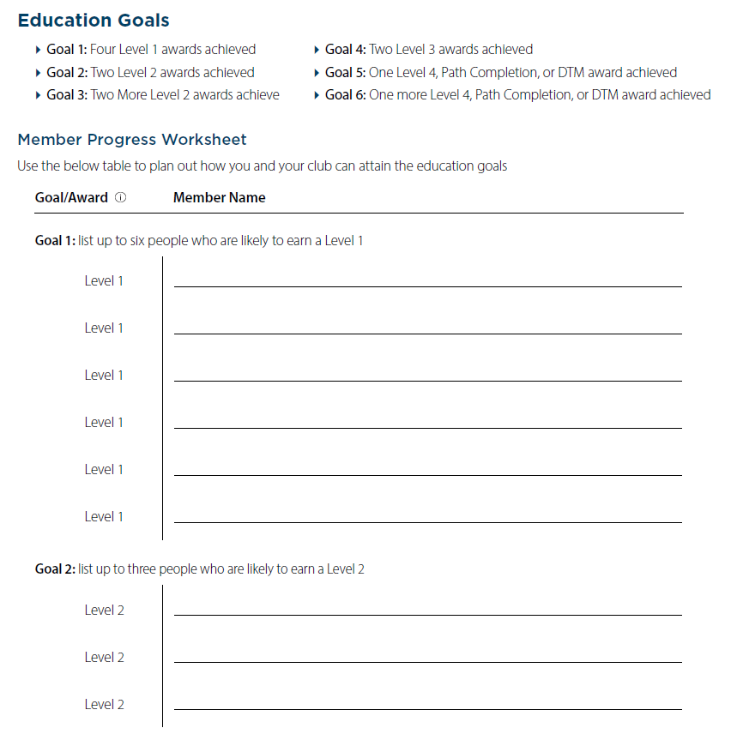

Slide 40
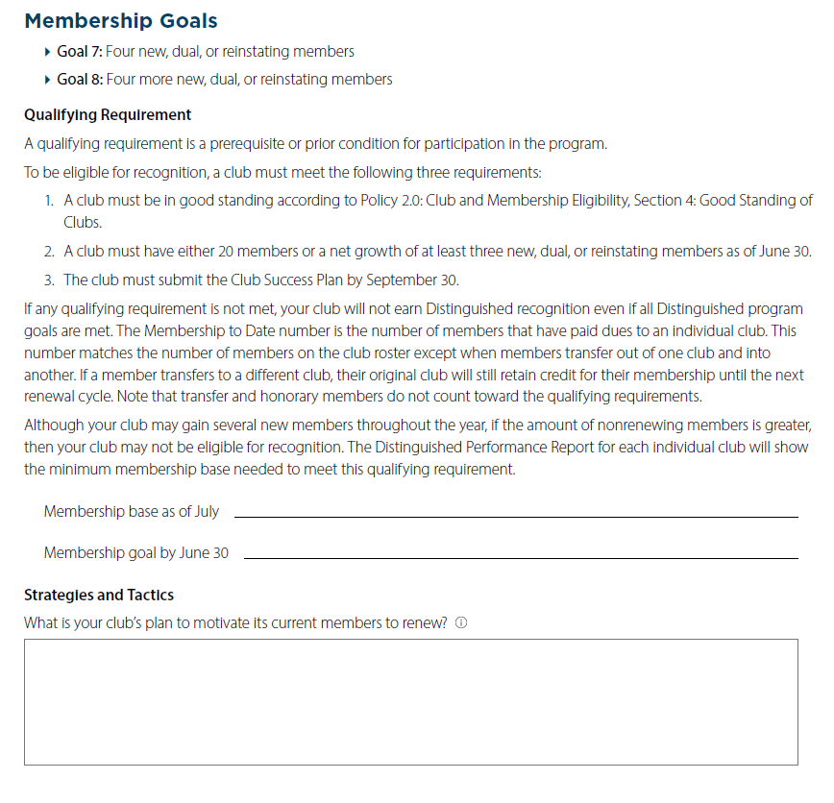

Slide 41
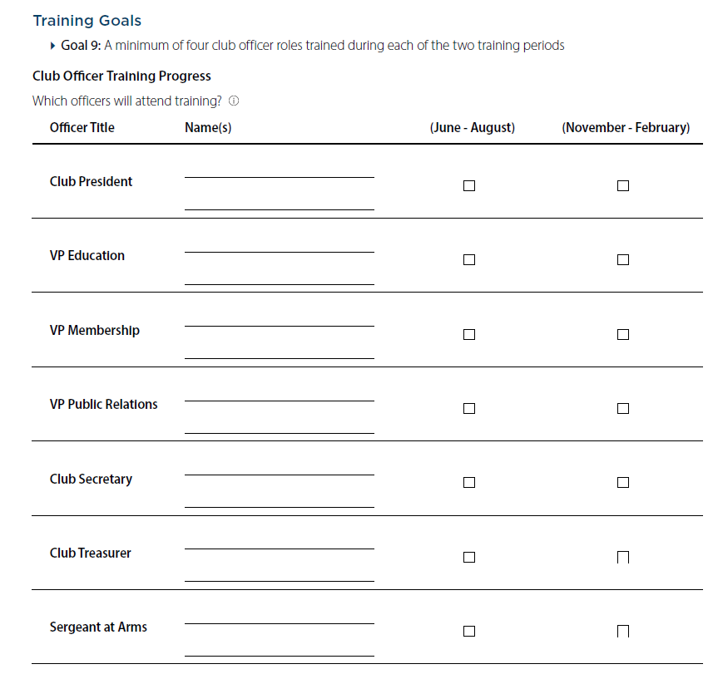

Slide 42
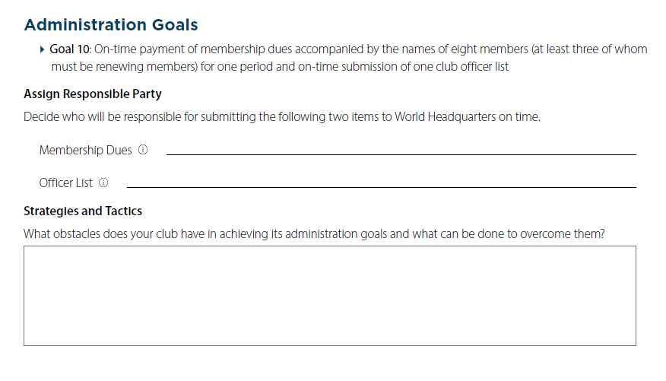

Slide 43
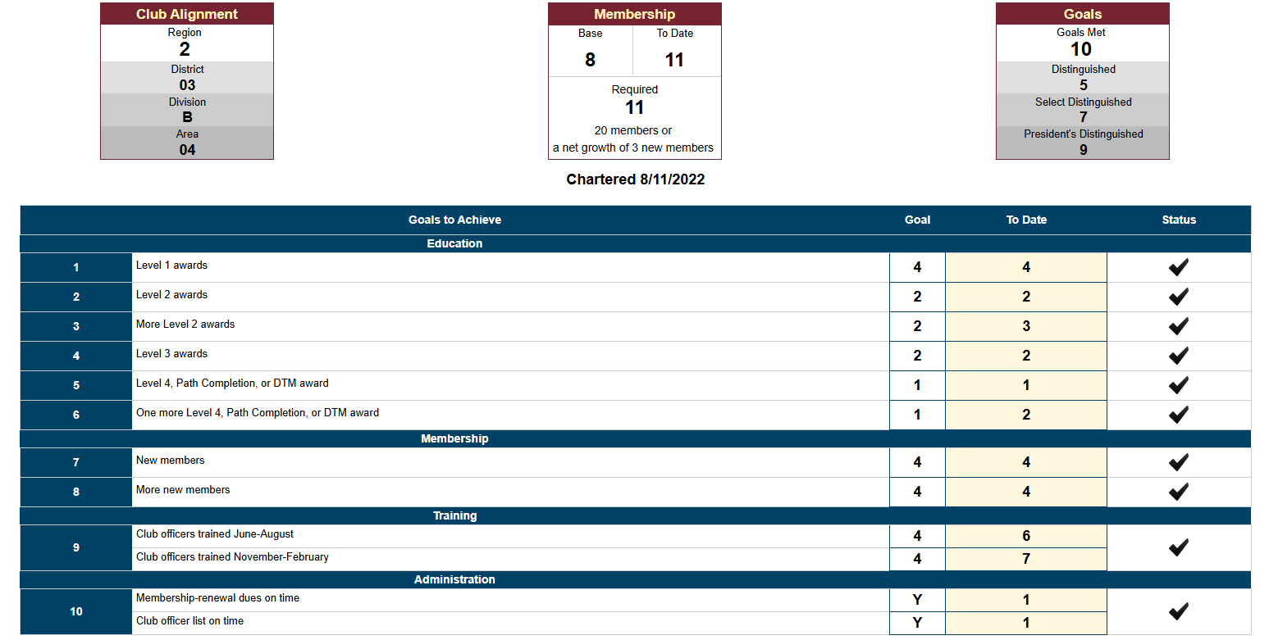

Slide 44
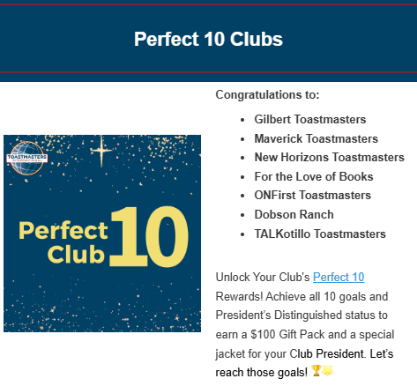
DID YOU KNOW?
The District has Club Incentives for achieving DCP Goals?

Slide 45
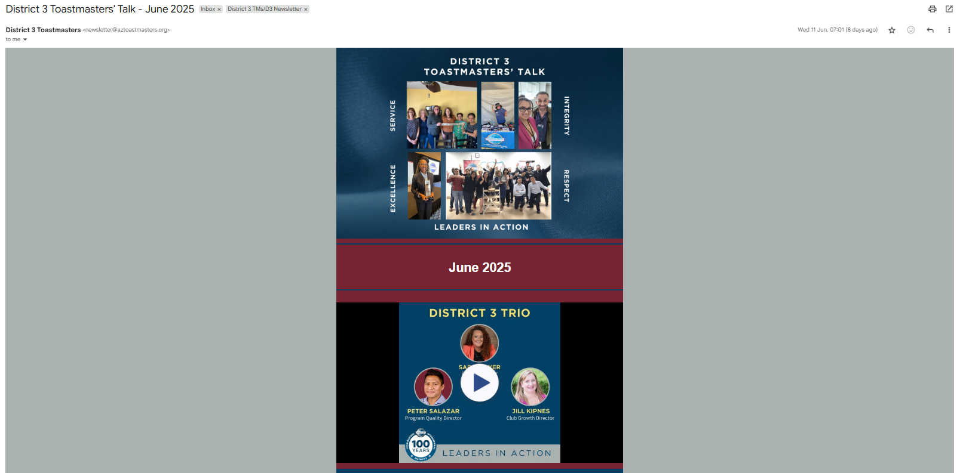
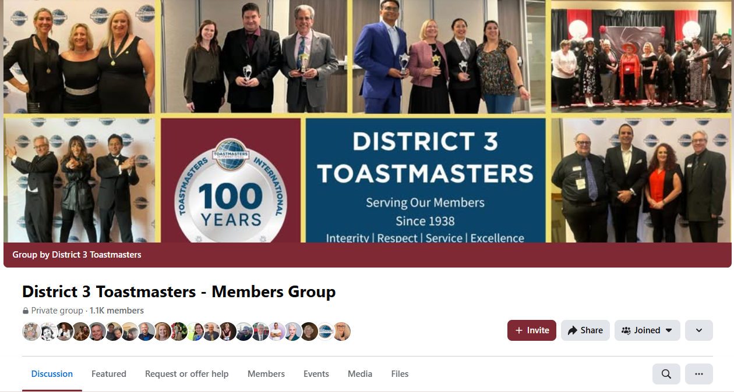
WHERE TO FIND THE INCENTIVES?
District 3 Toastmasters' Talk – monthly newsletter
Facebook Group

Slide 46
Ready for the Secret Weapon?

Slide 47

SHARE DCP WITH YOUR MEMBERS!

Slide 48
DCP WIIFM
WIIFM
What’s in it for me

Slide 49
DCP WIIFM – (What’s in it for me)
WHY SHOULD CLUB OFFICERS CARE?
More engaged Club Members
Better Club Morale
Better meetings
Club Longevity
Prestige & Recognition – Being part of a President’s Distinguished Club, or Smedley Distinguished Club means you’re in a top-performing Toastmasters club!

Slide 50
DCP FOR MEMBERS
DCP isn’t just goals for the Club Officers to meet!
Don’t keep it a secret from members!!!
It should be a Member Engagement Program!

Slide 51
DCP - Member Engagement Strategy
Member’s WIIFIM
  Fun & Uplifting Meetings
  Better Member Support
  Track Personal Progress
  Club Longevity
  Prestige & Recognition – Being part of a President’s Distinguished Club or Smedley Distinguished Club means you’re in a top-performing Toastmasters club!
  In short, when the members succeed, the club succeeds! 🚀

Slide 52
TRAIN YOUR MEMBERS
Spend time training the members
Every 2 – 3 months, update members
When you have a goal ticked off – SHARE IT!
Training new members, this is our club culture – to be the best!
Reminding existing members – their why, their WIIFM

Slide 53
TRAIN MEMBERS ON…
Pathways
  The different types of pathways
  Where are they in the pathways
  Their why for being here
  Have them set goals, how many speeches will they give?
DCP
  Keep members updated on the progress
    During club meetings
    Through club emails

Slide 54
HOW TO TRAIN MEMBERS
Present this presentation!!!
Amanda has given this presentation to clubs by request this year!
You can get a copy of this presentation to present yourself!

Slide 55
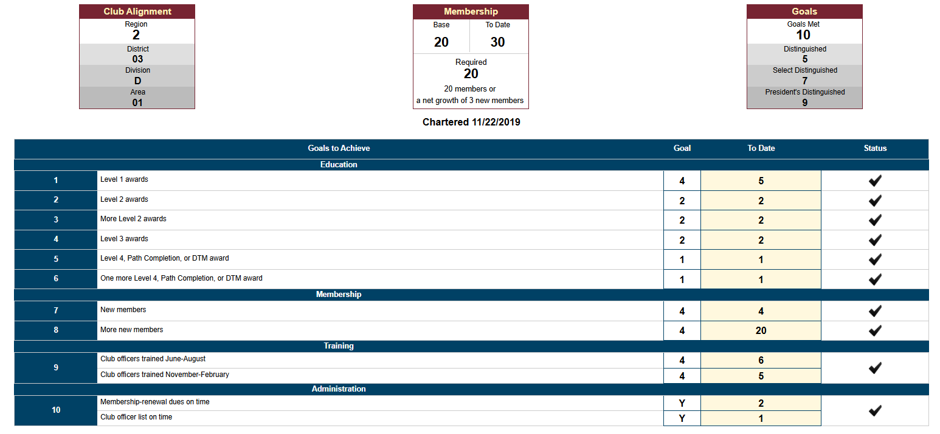
CLUB DCP GOALS!

Slide 56
Let’s work together!!
  Reminder
  Toastmasters year – July 1st to June 30th
    You have until June-30-2026 to reach the 10 goals.

Slide 57
Suggestions
  Hold a Speech-a-thon
  Plan your upcoming speeches in advance

Slide 58
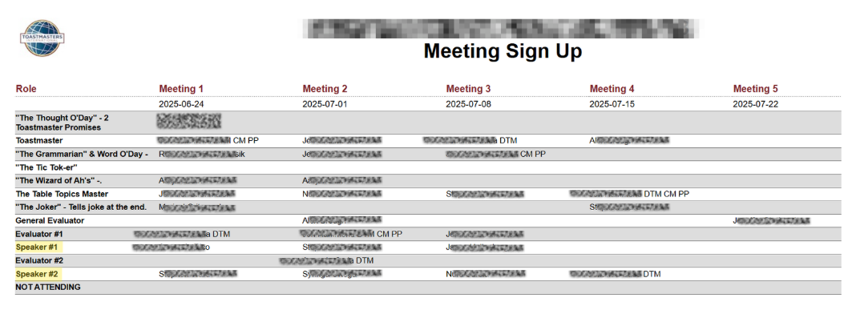
Schedule Meeting Roles in Advance

Slide 59
Together
  We are empowered to
  develop communication and leadership skills,
  resulting in greater self-confidence
  and personal growth…
  through regular practice!

Slide 60
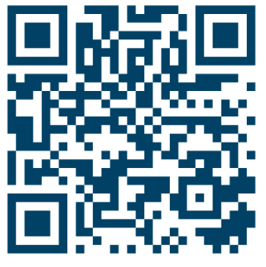
MY GIFT
Scan QR Code
Copy of this Presentation
My Contact Details
Access to book a Zoom Call with me
Videos of Past District Trainings

Slide 61

Let’s do it!

